Slide 2
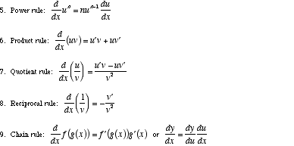
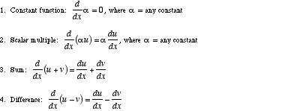


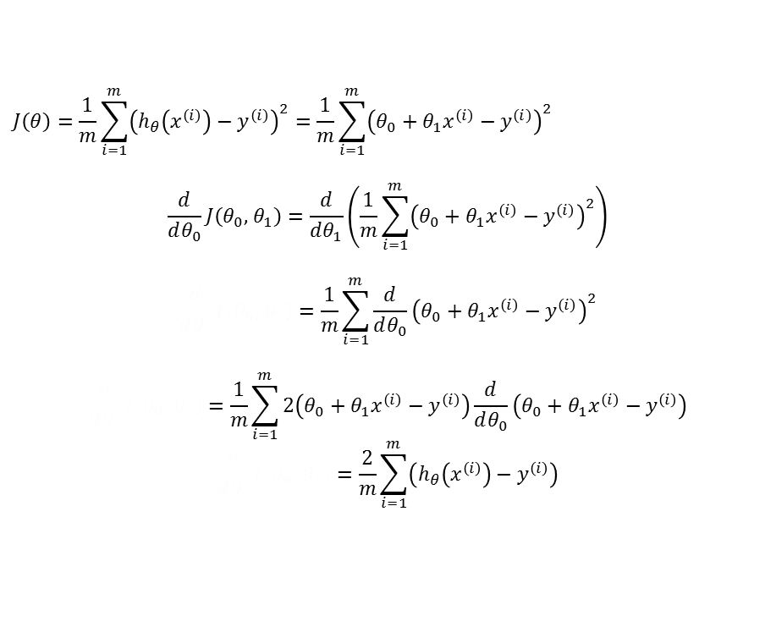
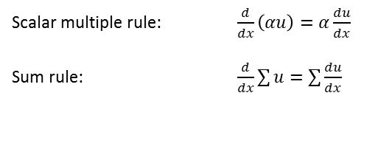
Gradient Descent MSE
$$h_{θ}\left(x\right)=θ_{0}+θ_{1}x$$
$$J\left(θ\right)=\frac{1}{m}\sum_{i=1}^{m}{{\left(h_{θ}\left(x^{\left(i\right)}\right)−y^{\left(i\right)}\right)}^{2}}=\frac{1}{m}\sum_{i=1}^{m}{{\left(θ_{0}+θ_{1}x^{\left(i\right)}−y^{\left(i\right)}\right)}^{2}}$$
$$\frac{d}{dθ_{0}}J\left(θ_{0},{ θ}_{1}\right)=\frac{d}{dθ_{1}}\left(\frac{1}{m}\sum_{i=1}^{m}{{\left(θ_{0}+θ_{1}x^{\left(i\right)}−y^{\left(i\right)}\right)}^{2}}\right)$$
$$\frac{d}{dθ_{1}}J\left(θ_{0},{ θ}_{1}\right)=\frac{1}{m}\sum_{i=1}^{m}{\frac{d}{dθ_{0}}{\left(θ_{0}+θ_{1}x^{\left(i\right)}−y^{\left(i\right)}\right)}^{2}}$$
$$\frac{d}{dθ_{1}}J\left(θ_{0},{ θ}_{1}\right)=\frac{1}{m}\sum_{i=1}^{m}{2\left(θ_{0}+θ_{1}x^{\left(i\right)}−y^{\left(i\right)}\right)\frac{d}{dθ_{0}}\left(θ_{0}+θ_{1}x^{\left(i\right)}−y^{\left(i\right)}\right)}$$
$$\frac{d}{dθ_{1}}J\left(θ_{0},{ θ}_{1}\right)=\frac{2}{m}\sum_{i=1}^{m}{\left(h_{θ}\left(x^{\left(i\right)}\right)−y^{\left(i\right)}\right)}$$
Scalar multiple rule: $\frac{d}{dx}\left(αu\right)=α\frac{du}{dx}$
Sum rule: $\frac{d}{dx}\sum{u}=\sum{\frac{du}{dx}}$
Power rule: $\frac{d}{dx}u^{n}=nu^{n−1}\frac{du}{dx}$
Chain rule: $\frac{d}{dx}f(g\left(x\right))=f^{′}\left(g\left(x\right)\right)g′(x)$

Slide 3

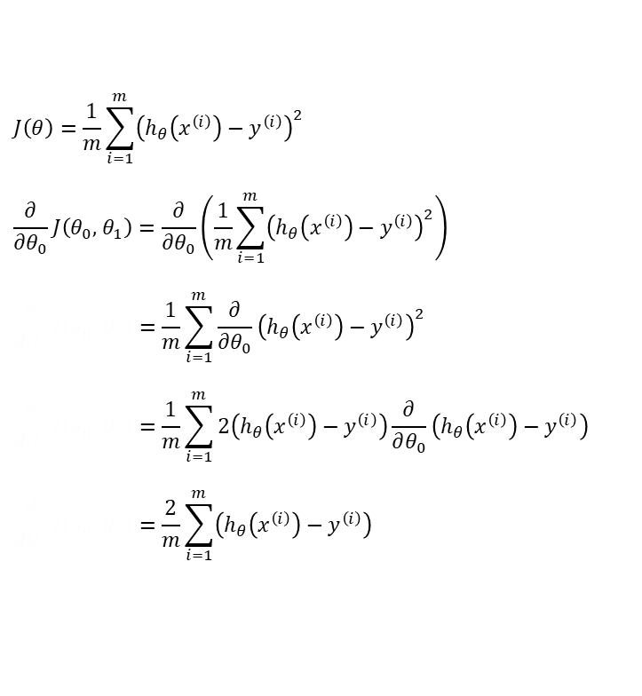

Gradient Descent MSE
$$J\left(θ\right)=\frac{1}{m}\sum_{i=1}^{m}{{\left(h_{θ}\left(x^{\left(i\right)}\right)−y^{\left(i\right)}\right)}^{2}}$$
$$\frac{∂}{∂θ_{0}}J\left(θ_{0},{ θ}_{1}\right)=\frac{∂}{∂θ_{0}}\left(\frac{1}{m}\sum_{i=1}^{m}{{\left(h_{θ}\left(x^{\left(i\right)}\right)−y^{\left(i\right)}\right)}^{2}}\right)$$
$$\frac{d}{dθ_{1}}J\left(θ_{0},{ θ}_{1}\right)=\frac{1}{m}\sum_{i=1}^{m}{\frac{∂}{∂θ_{0}}{\left(h_{θ}\left(x^{\left(i\right)}\right)−y^{\left(i\right)}\right)}^{2}}$$
$$\frac{d}{dθ_{1}}J\left(θ_{0},{ θ}_{1}\right)=\frac{1}{m}\sum_{i=1}^{m}{2\left(h_{θ}\left(x^{\left(i\right)}\right)−y^{\left(i\right)}\right)\frac{∂}{∂θ_{0}}\left(h_{θ}\left(x^{\left(i\right)}\right)−y^{\left(i\right)}\right)}$$
$$\frac{d}{dθ_{1}}J\left(θ_{0},{ θ}_{1}\right)=\frac{2}{m}\sum_{i=1}^{m}{\left(h_{θ}\left(x^{\left(i\right)}\right)−y^{\left(i\right)}\right)}$$
[1.0]
[1.1]
[1.2]
[1.3]
[1.4]
$$\frac{∂}{∂θ_{0}}\left(h_{θ}\left(x^{\left(i\right)}\right)−y^{\left(i\right)}\right)=\frac{∂}{∂θ_{0}}\left(θ_{0}+θ_{1}x^{(i)}−y^{\left(i\right)}\right)=1$$
$$\frac{∂}{∂θ_{1}}\left(h_{θ}\left(x^{\left(i\right)}\right)−y^{\left(i\right)}\right)=\frac{∂}{∂θ_{1}}\left(θ_{0}+θ_{1}x^{(i)}−y^{\left(i\right)}\right)=x$$

Slide 4
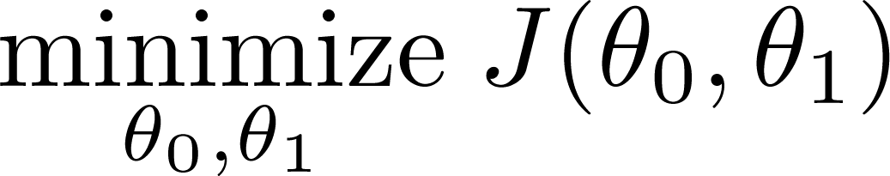
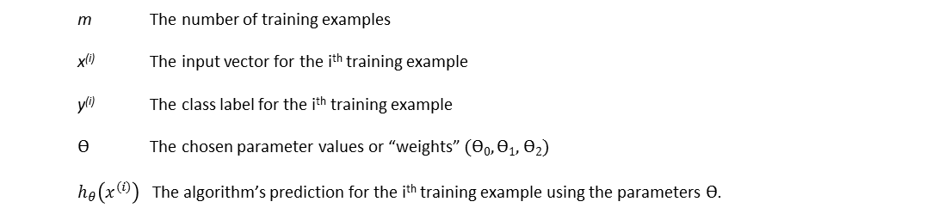
m The number of training examples
x^{(i)} The input vector for the i^{th} training example
y^{(i)} The class label for the i^{th} training example
Ѳ The chosen parameter values or “weights” (Ѳ₀, Ѳ₁, Ѳ₂)
$h_{θ}\left(x^{(i)}\right)$ The algorithm’s prediction for the i^{th} training example using the parameters Ѳ.

Slide 5
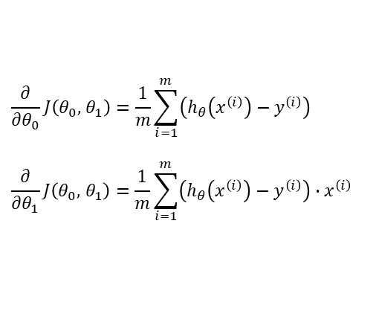
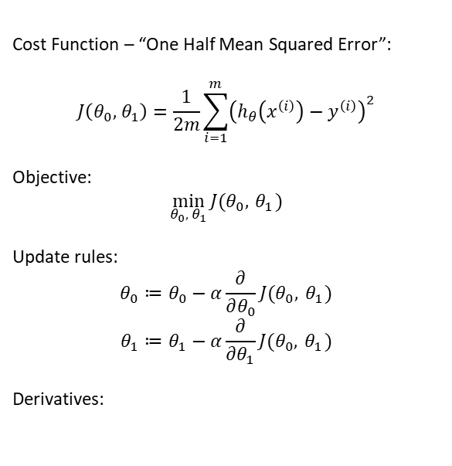
Gradient Descent MSE
Cost Function – “One Half Mean Squared Error”:
$$J\left(θ_{0},{ θ}_{1}\right)=\frac{1}{2m}\sum_{i=1}^{m}{{\left(h_{θ}\left(x^{\left(i\right)}\right)−y^{\left(i\right)}\right)}^{2}}$$
Objective:
$$\min_{θ_{0},{ θ}_{1}}{J(θ_{0},{ θ}_{1})}$$
Update rules:
$$θ_{0}≔θ_{0}−α\frac{∂}{∂θ_{0}}J(θ_{0},{ θ}_{1})$$
$$θ_{1}≔θ_{1}−α\frac{∂}{∂θ_{1}}J(θ_{0},{ θ}_{1})$$
Derivatives:
$$\frac{∂}{∂θ_{0}}J\left(θ_{0},{ θ}_{1}\right)=\frac{1}{m}\sum_{i=1}^{m}{\left(h_{θ}\left(x^{\left(i\right)}\right)−y^{\left(i\right)}\right)}$$
$$\frac{∂}{∂θ_{1}}J\left(θ_{0},{ θ}_{1}\right)=\frac{1}{m}\sum_{i=1}^{m}{\left(h_{θ}\left(x^{\left(i\right)}\right)−y^{\left(i\right)}\right)∙x^{\left(i\right)}}$$

Slide 6




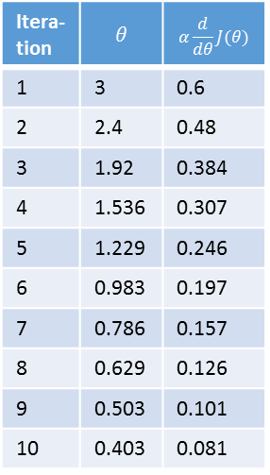
Gradient Descent 1D
$$θ≔θ−α\frac{d}{dθ}J(θ)$$
Itera-tion | $$θ$$ | $$α\frac{d}{dθ}J(θ)$$
1 | 3 | 0.6
2 | 2.4 | 0.48
3 | 1.92 | 0.384
4 | 1.536 | 0.307
5 | 1.229 | 0.246
6 | 0.983 | 0.197
7 | 0.786 | 0.157
8 | 0.629 | 0.126
9 | 0.503 | 0.101
10 | 0.403 | 0.081
$α=0.1$, $\frac{d}{dθ}J\left(θ\right)=2θ$
$$θ≔θ−0.2θ$$
$$\min_{θ}{J(θ)}$$

Slide 7
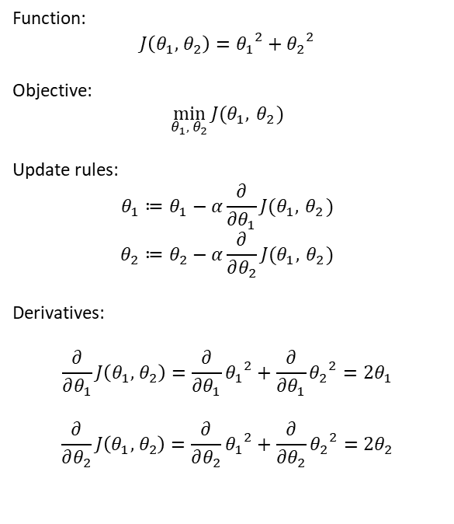
Gradient Descent 2D
Function:
$$J\left(θ_{1},{ θ}_{2}\right)={θ_{1}}^{2}+{θ_{2}}^{2}$$
Objective:
$$\min_{θ_{1},{ θ}_{2}}{J(θ_{1},{ θ}_{2})}$$
Update rules:
$$θ_{1}≔θ_{1}−α\frac{∂}{∂θ_{1}}J(θ_{1},{ θ}_{2})$$
$$θ_{2}≔θ_{2}−α\frac{∂}{∂θ_{2}}J(θ_{1},{ θ}_{2})$$
Derivatives:
$$\frac{∂}{∂θ_{1}}J\left(θ_{1},{ θ}_{2}\right)=\frac{∂}{∂θ_{1}}{θ_{1}}^{2}+\frac{∂}{∂θ_{1}}{θ_{2}}^{2}={2θ}_{1}$$
$$\frac{∂}{∂θ_{2}}J\left(θ_{1},{ θ}_{2}\right)=\frac{∂}{∂θ_{2}}{θ_{1}}^{2}+\frac{∂}{∂θ_{2}}{θ_{2}}^{2}={2θ}_{2}$$
Itera-tion | $$θ$$ | $$α\frac{d}{dθ}J(θ)$$
1 | 3 | 0.6
2 | 2.4 | 0.48
3 | 1.92 | 0.384
4 | 1.536 | 0.307
5 | 1.229 | 0.246
6 | 0.983 | 0.197
7 | 0.786 | 0.157
8 | 0.629 | 0.126
9 | 0.503 | 0.101
10 | 0.403 | 0.081
$$θ≔θ−0.2θ$$

Slide 8
